Slide 1
A PRESENTATION ON BY NARAYANA REDDY CHINNAPU REDDY

Slide 2
WHAT IS FUEL CELL…..???
A fuel cell is an electrochemical cell that converts the chemical energy into electrical energy through an electrochemical reaction of hydrogen fuel with oxygen or another oxidizing agent.
It requires continuous supply of a fuel and an oxidant to generate D.C electric power.
Every fuel cell has two electrodes called, respectively, the anode and cathode. The reactions that produce electricity take place at the electrodes.
fuel cell also has an electrolyte, which carries electrically charged particles from one electrode to the other, and a catalyst, which speeds the reactions at the electrodes.

Slide 3

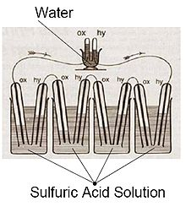
HISTORY OF FUEL CELL…!!!
In 1839, the first fuel cell was conceived by Sir William Robert Grove, a Welsh judge, inventor, and physicist.
He mixed hydrogen and oxygen in the presence of an electrolyte and produced electricity and water. The invention, which later became known as a fuel cell.
Sketch of William Grove's 1839 fuel cell

Slide 4
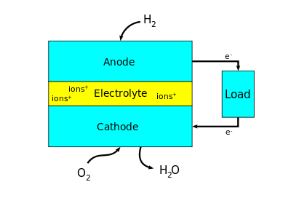
BLOCK DIAGRAM OF FUEL CELL

Slide 5
HOW DOES FUEL CELLS MAKE ELECTRICTY…!!!
A fuel cell needs three main components anode, cathode and an electrolyte to create the chemical reaction.
Here's how a fuel cell produces electricity:
Hydrogen gas from the tank (shown here as big brown blobs) feeds down a pipe to the positive terminal. Hydrogen is flammable and explosive, so the tank has to be extremely strong.
Oxygen from the air (big turquoise blobs) comes down a second pipe to the negative terminal.
The positive terminal (red) is made of platinum, a precious metal catalyst designed to speed up the chemistry that happens in the fuel cell. When atoms of hydrogen gas reach the catalyst, they split up into hydrogen ions (protons) and electrons (small black blobs).

Slide 6
Contd…
The protons, being positively charged, are attracted to the negative terminal (blue) and travel through the electrolyte (yellow) towards it. The electrolyte is a thin membrane made of a special polymer (plastic) film and only the protons can pass through it.
The electrons, meanwhile, flow through the outer circuit.
As they do so, they power the electric motor (orange and black) that drives the car's wheels. Eventually, they arrive at the negative terminal (blue) too.
At the negative terminal, the protons and electrons recombine with oxygen from the air in a chemical reaction that produces water.
The water is given off from the exhaust pipe as water vapour or steam.

Slide 7
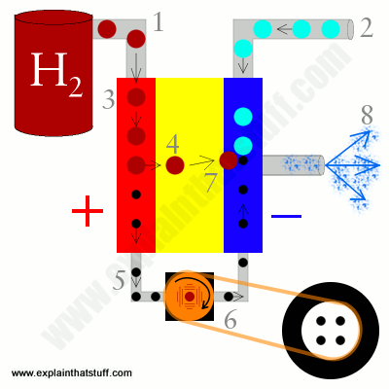

Slide 8
CLASSIFICATION OF FUE CELL
According to type of fuel and oxidant used,
H₂-O₂ Fuel cell
H₂- air fuel cell
Hydrazine -O₂ fuel cell
Ammonia- air fuel cell
Synthesis gas- air fuel cell
Hydrocarbon- air fuel cell
a)Hydrocarbon(gas)- air fuel cell
b)Hydrocarbon(liquid)- air fuel cell

Slide 9
Contd…
According to the type of electrolyte
Solid Oxide Fuel Cell (SOF)
Direct Methanol Fuel Cell (DMF)
Proton exchange membrane fuel cell (PEMFC)
Molten carbonate fuel cell (MCFC)
Alkaline fuel cell (AFC)
Phosphoric acid fuel cell (PCF)
Microbial Fuel Cells (MF)

Slide 10
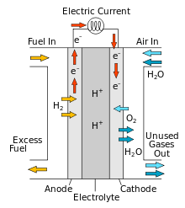
HYDROCARBON FUEL CELL (GAS)
The fuel cell is basically an energy-conversion device in which chemical energy is isothermally converted into dc electricity.
Several types of fuel cell systems have been developed, including the hydrogen-oxygen system used in certain space missions, but many of them employ fuels that are expensive and not readily available.
Considerable research and development work is being done on hydrocarbon-air systems, which use air and "real-world" fuels.
In the direct-oxidation cells, the hydrocarbon fuel is oxidized directly at the fuel electrode.

Slide 11
Contd…
Because of reaction problems at the electrode, these cells are still in their early stages of development.
In the indirect-oxidation cells, now in the systems engineering development stage, the hydrocarbon fuel is converted into an impure hydrogen, which may then be purified to a certain degree and injected into the fuel cell modules.
Initial applications will probably be in the military, because of the fuel flexibility and ease of maintenance inherent in these fuel cell systems.

Slide 12
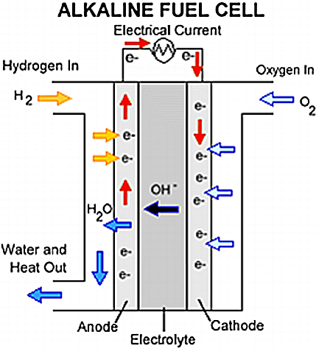
AMMONIA–OXYGEN FUEL CELL
A diagram of the operating principle of direct ammonia fuel cells based on an alkaline electrolyte is shown in Figure.
At the cathode, oxygen is reduced to OH⁻ ions in the presence of water, as in other alkaline fuel cells.
This yields hydroxide ions which then transfer to the anode and react with ammonia to form nitrogen and water
O₂ + 2H₂O + 4e⁻ → 4 OH⁻ cathode reaction E⁰ = + 0.40 V 2NH₃ + 6
OH⁻ → N₂ + 6H₂O + 6 e⁻ anode reaction E⁰ = − 0.77 V 4NH₃ + 3 O₂ →
2 N₂ + 6 H₂O overall reaction E⁰ = + 1.17 V

Slide 13
PROTON EXCHANGE MEMBRANE FUEL CELL (PEMFC)
Polymer electrolyte membrane (PEM) fuel cells—also called proton exchange membrane fuel cells—deliver high power density and offer the advantages of low weight and volume compared with other fuel cells. PEM fuel cells use a solid polymer as an electrolyte and porous carbon electrodes containing a platinum or platinum alloy catalyst. They need only hydrogen, oxygen from the air, and water to operate. They are typically fuelled with pure hydrogen supplied from storage tanks or reformers.
PEM fuel cells operate at relatively low temperatures, around 80°C (176°F). Low-temperature operation allows them to start quickly (less warm-up time) and results in less wear on system components, resulting in better durability. However, it requires that a noble-metal catalyst (typically platinum) be used to separate the hydrogen's electrons and protons, adding to system cost.

Slide 14
Contd…
The platinum catalyst is also extremely sensitive to carbon monoxide poisoning, making it necessary to employ an additional reactor to reduce carbon monoxide in the fuel gas if the hydrogen is derived from a hydrocarbon fuel. This reactor also adds cost.
PEM fuel cells are used primarily for transportation applications and some stationary applications. Due to their fast start up time and favourable power-to-weight ratio, PEM fuel cells are particularly suitable for use in passenger vehicles, such as cars and buses.

Slide 15
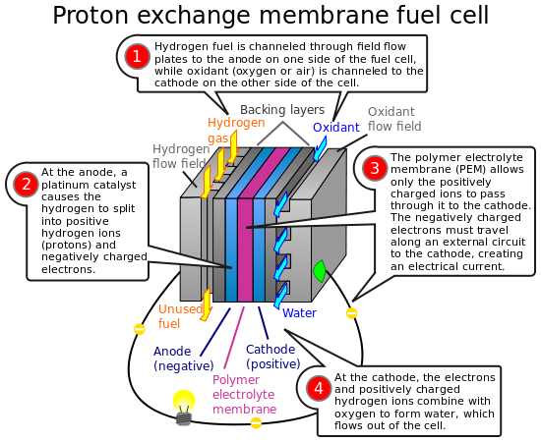
PEM fuel cells operate at around 80°C and a practical efficiency of 60%. Power output is in the range of 5-200 kW. They are ideal for transportation and portable power. Additional advantages are their high response, the small size and low cost.
An attractive future development is the Direct Methanol Fuel Cell (DMFC). This uses methanol as a fuel for fuel cells by reforming it into hydrogen because of the capacity of safe hydrogen storage and transportation that methanol provides. DMFC is basically used in transportation
Electrochemical Equation:
Anode: H₂ ®2H⁺ + 2e⁻
Cathode: ½ O₂ + 2H⁺ + 2e⁻ ® H₂O
Cell: H₂ + ½ O₂ ® H₂O

Slide 16
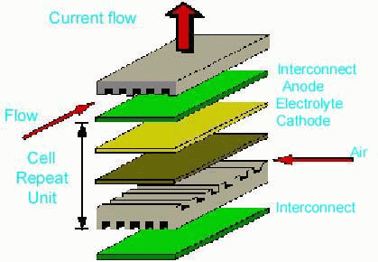
SOLID OXIDE FUEL CELL (SOFC)
They operate at high temperatures (1000-1100°C) and a practical efficiency 50-60%. They are not the most reactive because of the low conductivity of its ionic conducting electrolyte. Because of the conductivity and heat, They have been used in large power plants which can use the cogeneration of steam for additional power. The primary drawback to this type of fuel cell is the cost of containment which requires ceramics which are difficult to fabricate in forms and shapes that can accommodate the high thermal stresses. They can be used in power back for outdoor recreation (small tubular system) and in micro CHP systems in residences
Electrochemical Equation:
Anode: H₂ + O₂ →H₂O + 2 e⁻
Cathode: ½ O₂ + 2e⁻ → O²⁻
Cell: H₂ + ½ O₂ → H₂O

Slide 17
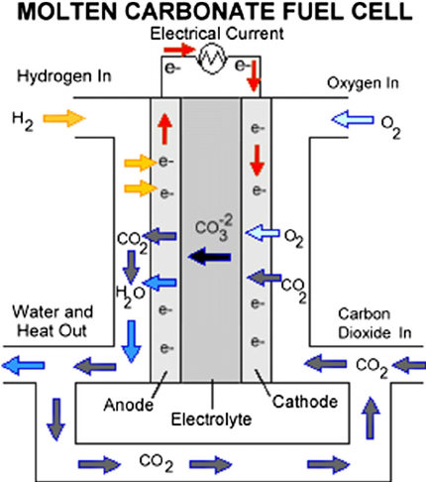
MOLTEN CARBONATE FUEL CELL (MCFC)
They operate at 600°C and can use CO as a fuel input on the cathode side but need hydrogen on the anode. The temperature is high enough to be used for additional power production through cogeneration of steam. The efficiency of these type of fuel cells has risen to 50% in a combined (electrical and steam) cycle. They can also be used in mega-watt size power plants because of their heat.
Electrochemical Equation:
Anode: H₂ + CO₃²⁻ →H₂O +CO₂ + 2 e⁻
Cathode: ½ O₂ + CO₂ + 2e⁻ → CO₃²⁻
Cell: H₂ + ½ O₂ + CO₂ → H₂O + CO₂

Slide 18
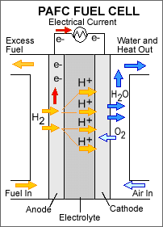
PHOSPHORIC ACID FUEL CELL (PAFC)
PAFCs have an operating temperature of 200 °C. The efficiency of this system is much lower than that of the other systems at 40%. It is the FC that has mostly been exploited, mainly due to its high grade heat, which can be used in small-scale CHP especially at military sites and UPS systems fuelled with hydrogen, natural gas, LPG and methane from waste water purification plants.
The power output varies from 200 kW to 20 MW. The main disadvantage is that it has no self-starting capability, because at lower temperatures (40-50 °C) freezing of concentrated Phosphoric Acid occurs. In order to reduce losses, the cathode catalyst and the reformer need to be improved.
Electrochemical Equation:
Anode: H₂ ®2H⁺ + 2e⁻
Cathode: ½ O₂ + 2H⁺ + 2e⁻ ® H₂O
Cell: H₂ + ½ O₂ ® H₂O

Slide 19
ALKALINE FUEL CELL (AFC)
The operating temperature of AFCs is about 70°C and their power output is 10-100 kW. They have been widely used for space and defense applications, where pure hydrogen is used. Their excessive cost and sensitivity to CO₂ , have restricted their research and development, no matter their high efficiency and power density.
Electrochemical Equation:
Anode: H₂ + 2(OH)⁻ → 2H₂O + 2 e⁻
Cathode: ½ O₂ + HO₂ + 2e⁻ → 2(OH)⁻
Cell: H₂ + ½ O₂ + CO₂ → H₂O

Slide 20
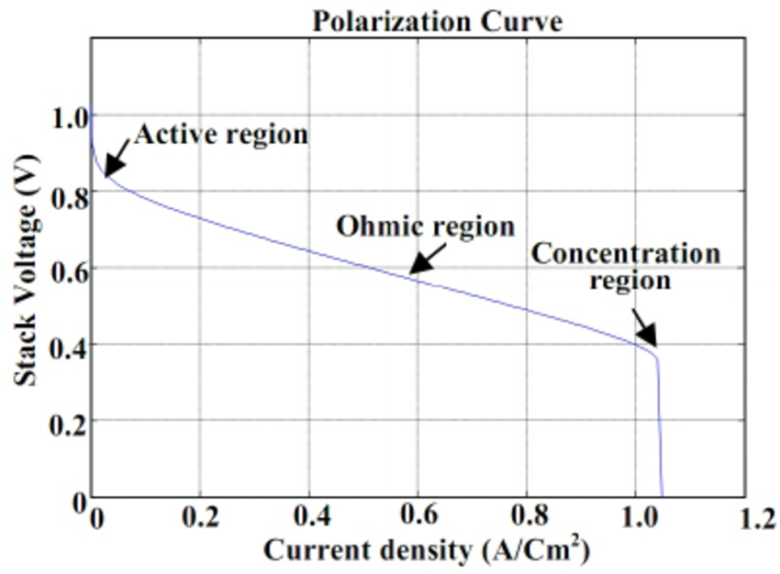
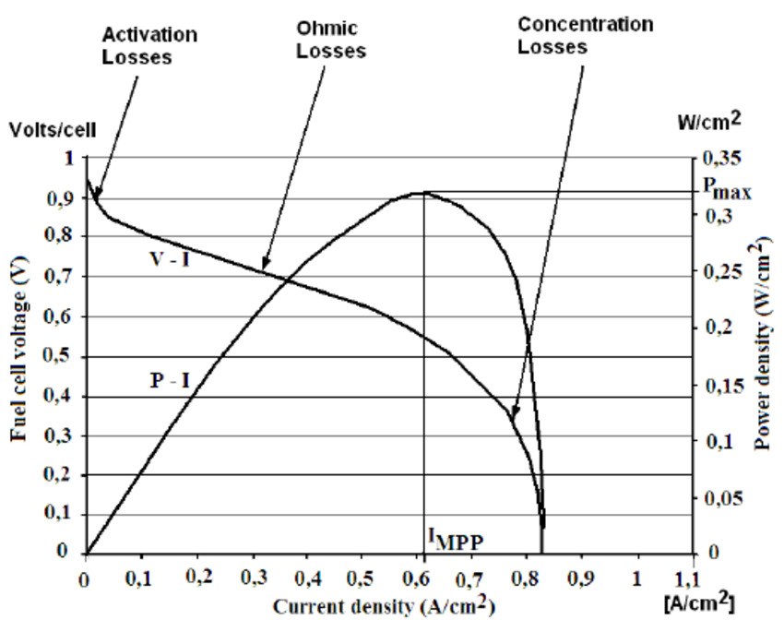
VI- CHARACTERISTICS
time(seconds)
V-I CHARACTERISTICS OF PEM FUEL CELL
POLARIZATION AND POWER FOR TYPICAL PEM CELL

Slide 21
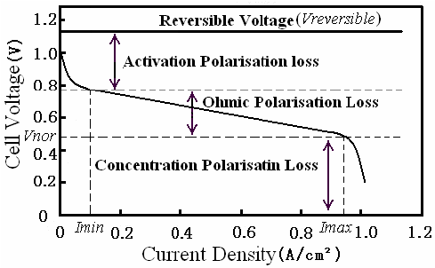
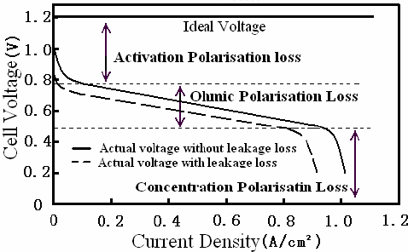
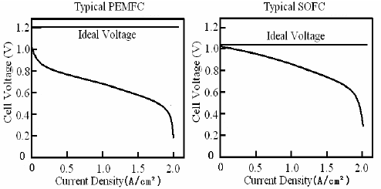
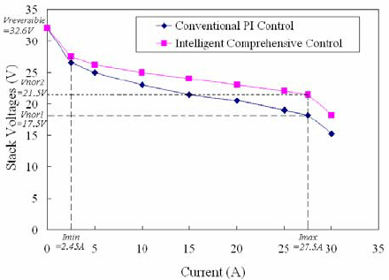
Performance comparison of typical PEMFC vs. typical SOFC
Ideal and actual performance curves of a PEMFC
Performance curve of a PEMFC fuel cell

Slide 22
COMPARISION OF FUEL CELLS
ASPECT | Solid Oxide | Molten Carbonate | Phosphoric Acid | Proton Exchange Membrane
Electrolyte | Yttria-Stabilised Zirconia | Alkali Carbonates Mixture | Phosphoric Acid | Ion Exchange Membrane
Operating Temperature (°C) | 1000 | 650 | 200 | 80
Charge Carrier | O⁼ | CO₃⁼ | H⁺ | H⁺
Electrolyte State | Solid | Immobilised Liquid | Immobilised Liquid | Solid
Cell Hardware | Carbon or Metal Based | Stainless Steel | Graphite Based | Carbon or Metal Based
Catalyst | Ceramic | Nickel | Platinum | Platinum
Cogeneration Heat | High | High | Low Quality | None
Fuel Cell Efficiency (%) | 50-60% | 50-60% | 40-45% | 60%

Slide 23
EFFICIENCY OF FUEL CELL
OPERATING EFFICIENCY OF FUEL CELLS:
It is defined as the efficiency to convert the chemical energy of fuel into electrical energy. The overall efficiency of fuel cells is always below 100%.
η_{over all} = η_{therm .} η _{volt .} η_{coul} . Η_{design}
Thermodynamic efficiency (η_{therm} ):
it is expressed as,
η_{therm} = Q _{react} – Q _{lat} / Q _{react}
And,
Q _{react} = W_{e} + Q _{lat}
where,
Q _{react} = reaction enthalpy
Q _{lat} = latent heat in reactions
W_{e} = energy of current flowing

Slide 24
Voltage Efficiency(η_{VOLT}):
it is expressed as,
(η_{VOLT})= u_{i}/ε˚
Where,
u_{i} = operating voltage at current density “I”
ε˚ = E.M.F value of a fuel cell
In case of hydrogen-oxygen fuel cells, the values of ε˚ at 25˚C is 10299 V.
Coulombic Efficiency(η_{coul}):
It is generally known as faradaic efficiency. All the reactants in a fuel cell may not be used for producing electrical energy or coulombs. This may be due to the reasons like leakages from various points, incomplete oxidation of fuel, etc. thus, Coulombic Efficiency is the efficiency if utilising reactions, to produce electrical energy.
Design efficiency(η_{design}):
The fuel cell generates the electrical energy, a part of which is also used for operating equipment like pumps and control devices. Design quality is also the major factor for leakages. Thus, design of a fuel cell must be efficient. In order to optimise the power needs of the equipment and enhance the cell output.
Thus, the overall efficiency is the product of all the above efficiencies and is an important for that influences the power generation.

Slide 25
DIFFERENCE BETWEEN FUEL CELL AND BATTERY
FUEL CELL:
A fuel cell makes its electricity from fuel in an external fuel tank.
Fuel cell is open system.
There is no change in chemical composition of electrolyte.
Fuel supply continuous.
Isothermal reaction inside.
Fuel cell supply power for indefinite length of time.
High cost.
Durable
efficiency is about 83%
BATTERY:
A battery makes electricity from the energy it has stored inside the battery.
Battery is a close system.
Chemical Changes occurs.
Fuel supply intermittent.
No isothermal reaction inside.
Supply power for definite length of time.
Low cost.
Short-lived.
Efficiency is about 99% (LI-ion)

Slide 26
ADVANTAGES & DISADVANTAGES OF FUEL CELL
Advantage
Hydrogen Most abundant element.
Hydrogen has the highest energy content.
Hydrogen is non-polluting.
Hydrogen is a renewable fuel source.
Reduce dependency on foreign oil.
Fuel cells operate silently.
No pollution since there is no combustion.
Fuel cells have a higher efficiency than diesel or gas engines.
Disadvantage
Expensive to manufacture due the high cost of catalysts (platinum)
Lack of infrastructure to support the distribution of hydrogen
A lot of the currently available fuel cell technology is in the prototype stage and not yet validated.
Hydrogen is expensive to produce and not widely available.
Storing hydrogen is very expensive.
Hydrogen gas is Flammable.
Fossil Fuels Are Still Needed

Slide 27
APPLICATIONS
Portable Power
Backup Power
Transportation Applications
Automobiles
buses
military applications
Scooters and Bicycles
Stationary Power Applications
Forklifts and Materials Handling
Auxiliary Power Units (APUs)
Trains
Planes
Boats

Slide 28



MY TRIBUTES
MULTI TALENTED- NIKOLA TESLA
MISSILE MAN OF INDIA- A.P.J ABDUL KALAM
FATHER OF ELECTRICAL ENGINEERING- MICHAEL FARADY

